Slide 1

Climate Mitigation and Other SDGs
PLCY-798K
Integrated Human-Earth System Modeling and Policy Assessment
April 12, 2023
Notes:
Syllabus text: Apr 12. Climate Mitigation and Other SDGs: using IAM to explore the synergies and tradeoffs between
climate mitigation and other sustainable development goals, such as air quality and human health, food
security, energy security, and others.

Slide 2
Agenda
1:40 – 2:45: Section I
What are SDGs and how do they relate to mitigation research and IAMs?
Which are key synergies and trade-offs between different SDGs?
Empirical literature
IAM literature →
What policies and measures can help exploit synergies and minimize trade-offs?
2:45 Break
2:45 – 4:00 Section II
GCAM tutorial – creating input files using headers

Slide 3
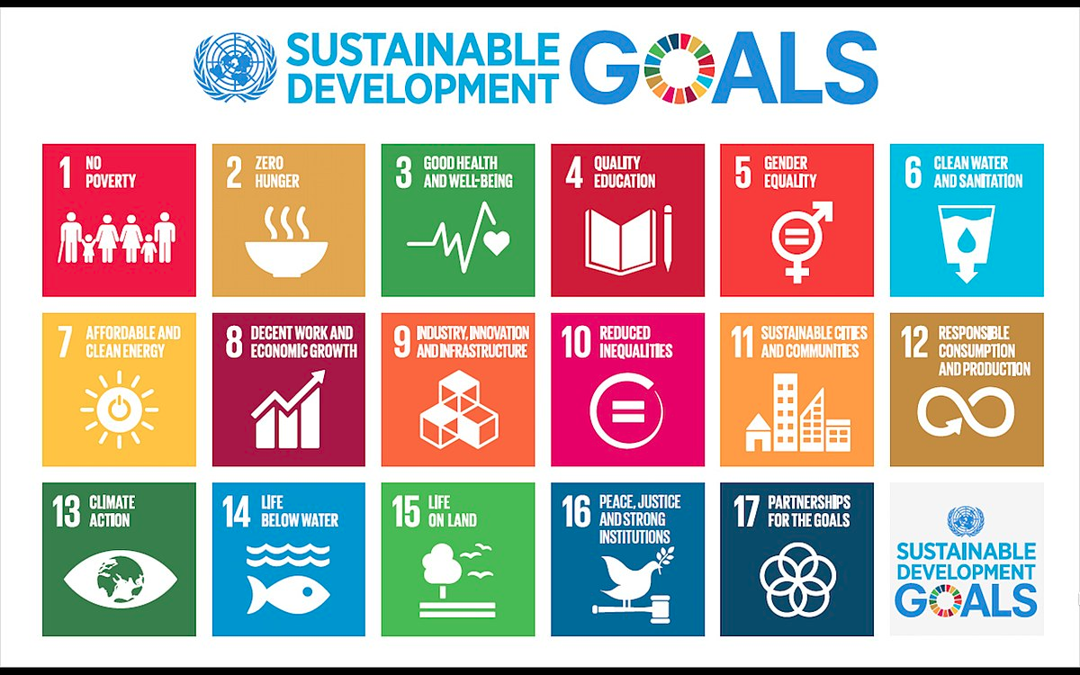
1. What are the SDGs? 17 Sustainable Development Goals – each with specific targets, mostly for 2030 (169 targets, 232 indicators)

Slide 4
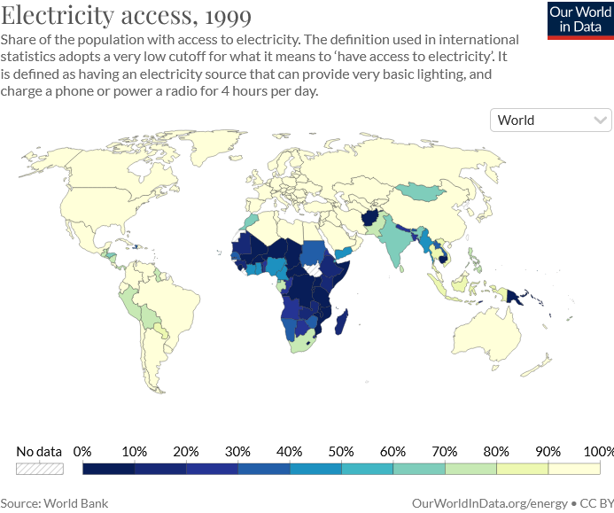
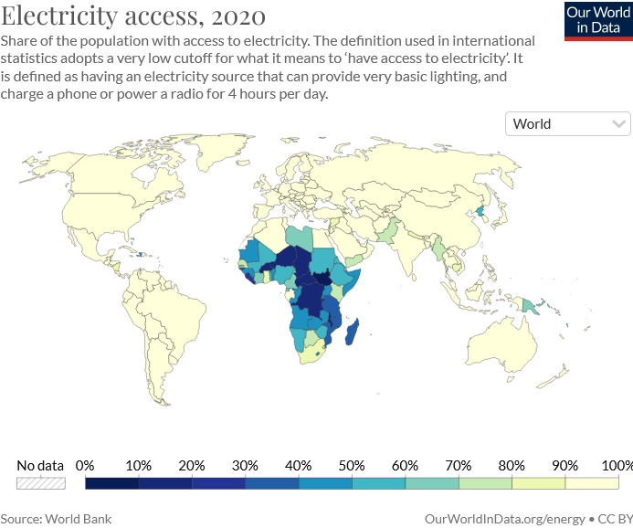
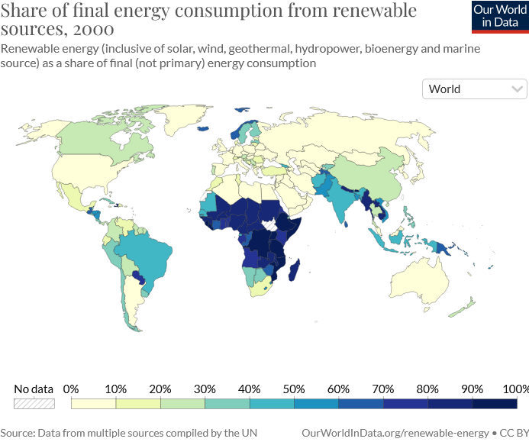
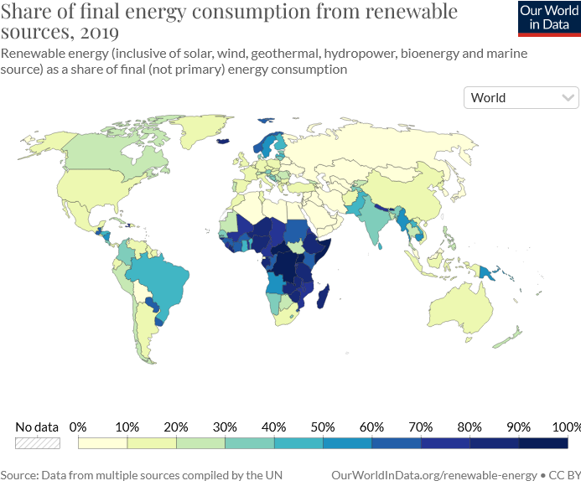
SDG target tracker https://sdg-tracker.org
Target 7.1: Universal access to modern energy
Target 7.2: Increase global percentage of renewable energy
Target 7.3: Double the improvement in energy efficiency
Target 7.A: Promote access, technology and investments in clean energy
Target 7.B: Expand and upgrade energy services for developing countries
Notes:
Target 13.1: Strengthen resilience and adaptive capacity to climate-related disasters
Target 13.2: Integrate climate change measures into policy and planning
Target 13.3: Build knowledge and capacity to meet climate change
Target 13.A: Implement the UN Framework Convention on Climate Change
Target 13.B: Promote mechanisms to raise capacity for planning and management

Slide 5
How do they relate to IAMs? → Clustering SDGs
Source: van Soest et al. (2019)

Slide 6
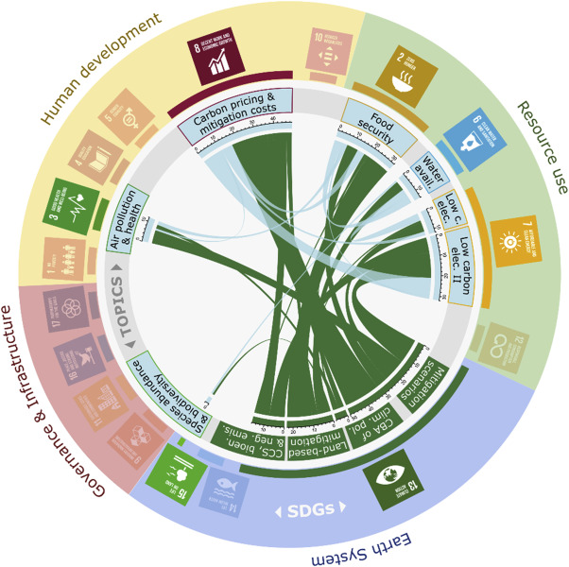
SDG representation in IAM literature
Many SDGs can (partly) be quantified by IAMs especially in ‘Efficient & sustainable resource use’ + ‘Prevent environmental degradation’ clusters
More challenging in ‘Human development goals’ + ‘Good governance and infrastructure’
van Soest et al. (2019)

Slide 7
Use IAM to quantify SDGs
Many SDGs can (partly) be quantified by IAMs
Especially in ‘Efficient & sustainable resource use’ + ‘Prevent environmental degradation’ clusters
Interactions mainly in and between ‘Efficient and sustainable resource use’ and ‘Prevent environmental degradation’ clusters - & links with economy
Quantification more challenging in ‘Human development goals’ + ‘Good governance and infrastructure’
Institution/policy/legal framework indicators
Key planned (by now ongoing) developments: poverty→hunger, hunger & water → health
Some SDGs not (yet) quantifiable in IAMs (inequalities, education, peace, cities, oceans)
Source: van Soest et al. (2019)

Slide 8
IAM study examples
IAM community has been evaluating societally relevant metrics (similar to SDGs) for a long time
Examples from
(1) energy and food security under climate mitigation;
(2) air quality and human health under climate mitigation;
(3) national mid-century climate change strategies that include multiple societally relevant metrics.

Slide 9
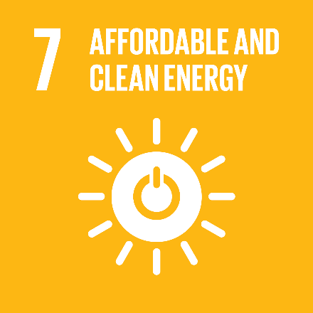


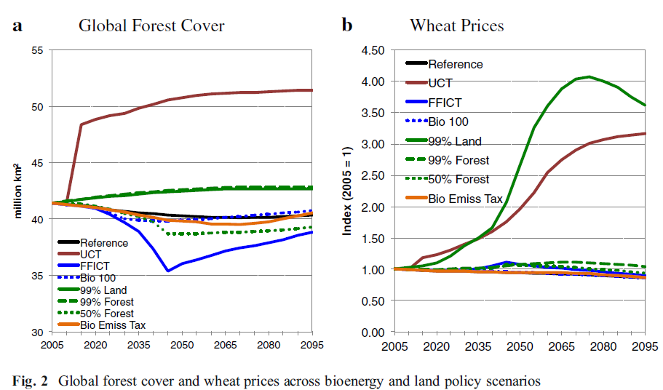
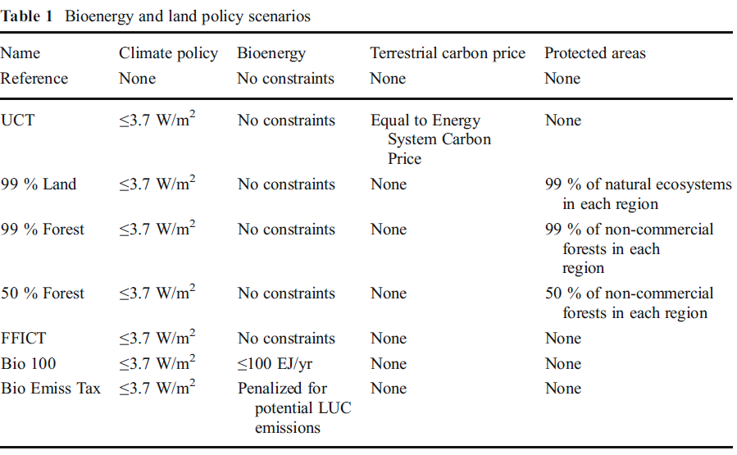
Trade-offs of different land and bioenergy policies on the path to achieving climate targets
Calvin et al. (2014), Climatic Change

Slide 10
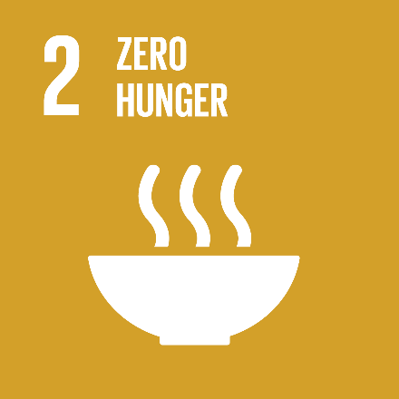
Trade-offs of different land and bioenergy policies on the path to achieving climate targets
Calvin et al. (2014), Climatic Change

Slide 11
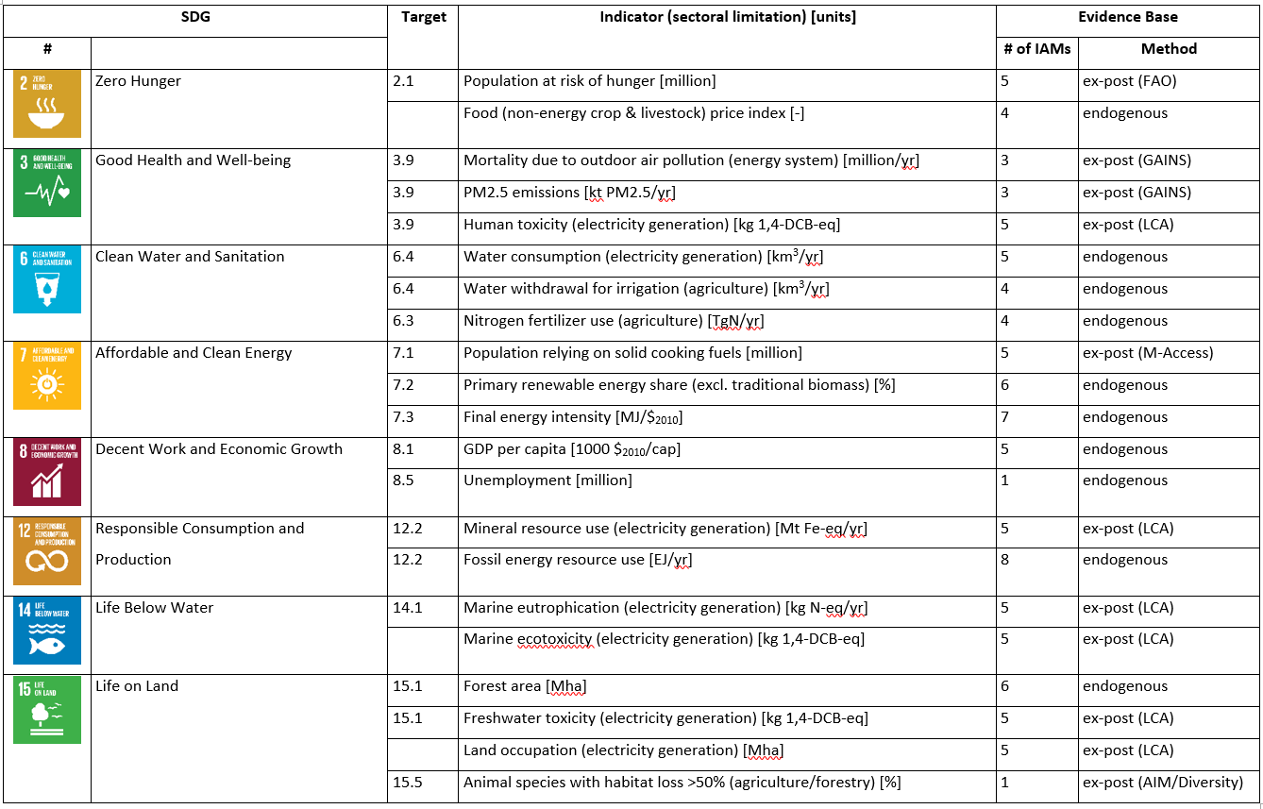
SDG Indicators and Modeling Tools
CD-Links Project http://www.cd-links.org

Slide 12
Many IAMs try to optimize (explicitly or implicitly) social welfare (human well-being) SDGs try to operationalize both human well-being, and its different preconditions more explicitly
Max U(C) ? Min $ ?
Multi-criteria optimization ?
Human development
Governance
Implicit assumptions
Some newer studies
Earth System
Resource use
Notes:
Link to Iyer et al.

Slide 13
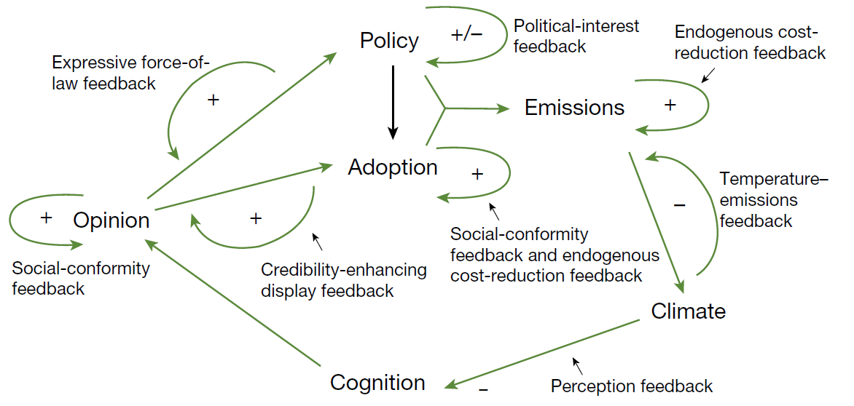
Full coupling – first (very stylized) attempt
Human development
Resource use
Governance
Earth System
Source: Moore et al. (2022)

Slide 14
Summary section 1.:
SDGs are goals of global human development that the UN GA has agreed on in 2015
Intent to comprehensively cover all relevant aspects of human development, resource use, governance, and earth system
IAMs have traditionally tracked subset of interactions among those systems well
Comprehensive coverage of interactions in one modeling framework still illusionary

Slide 15
SDG interactions

Slide 16
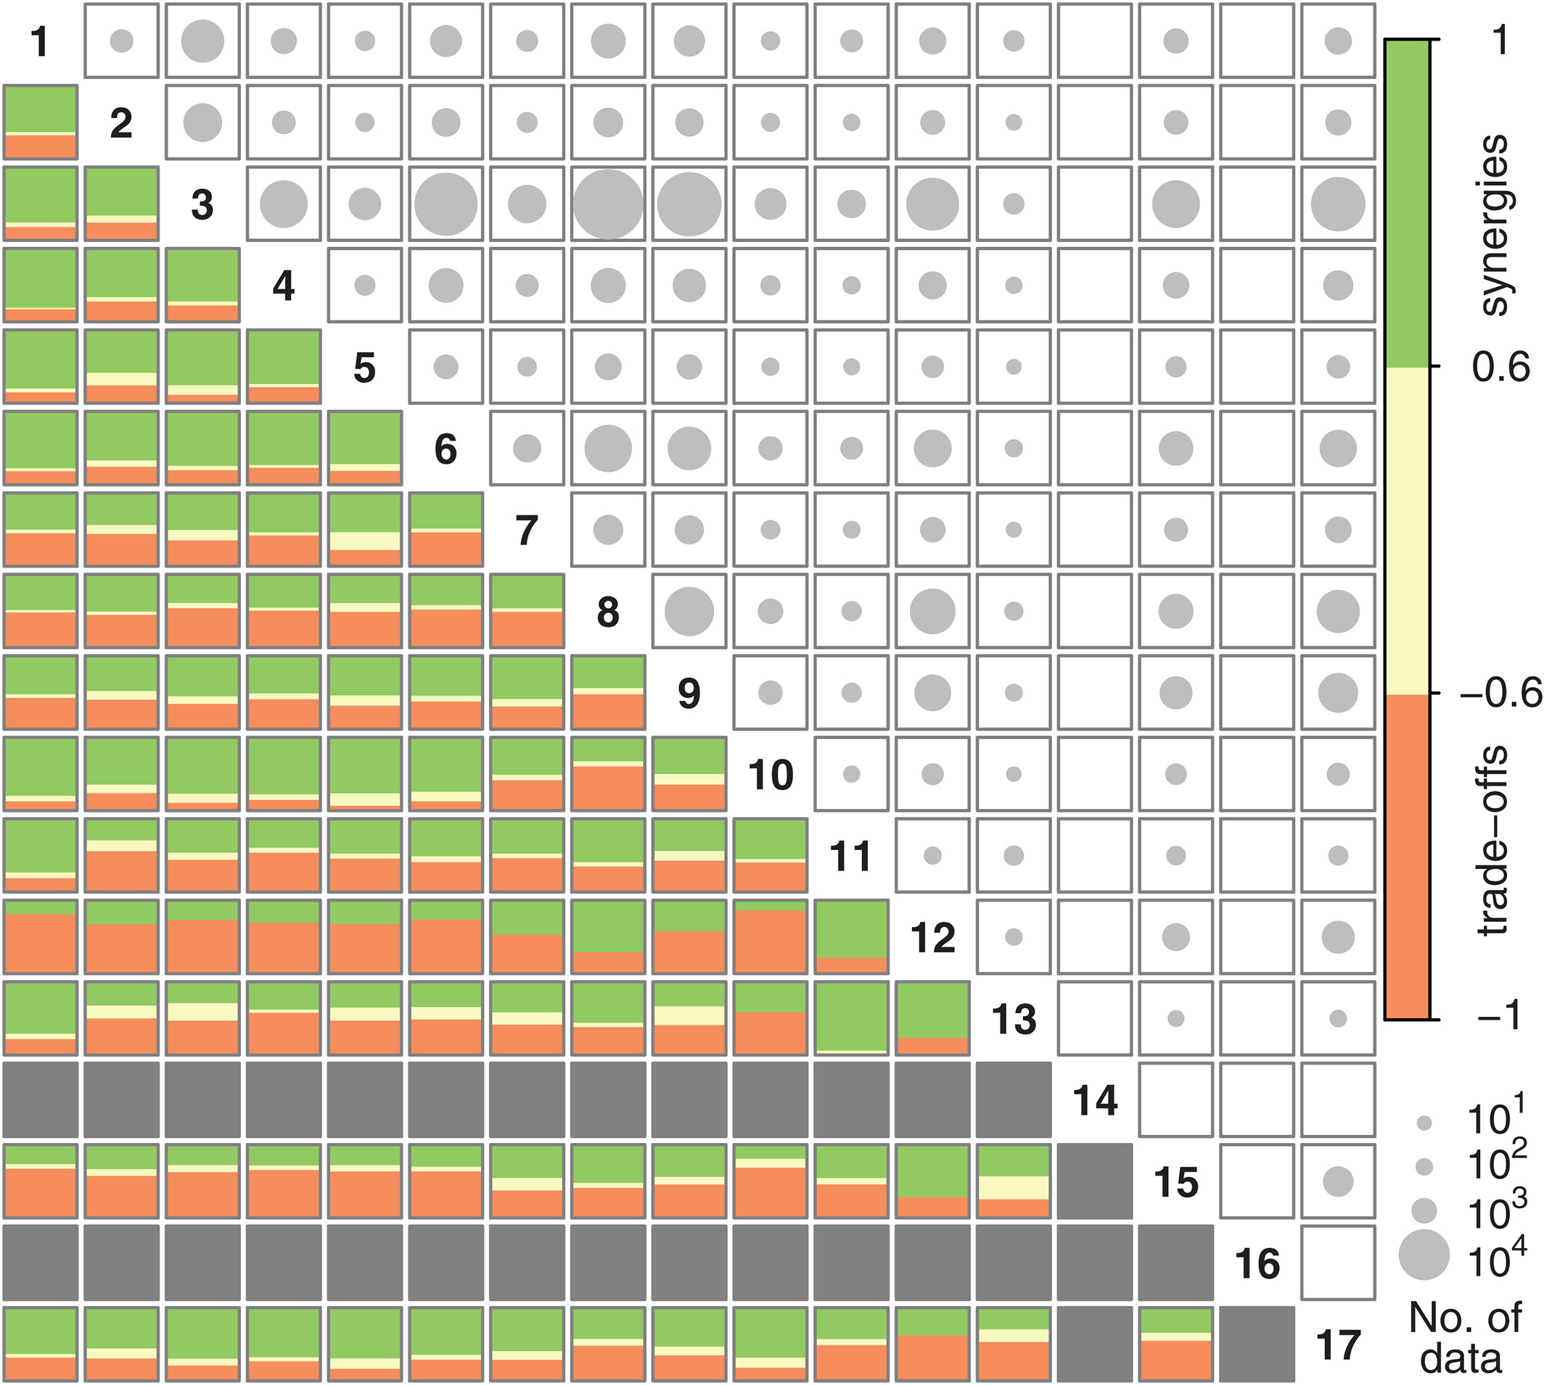
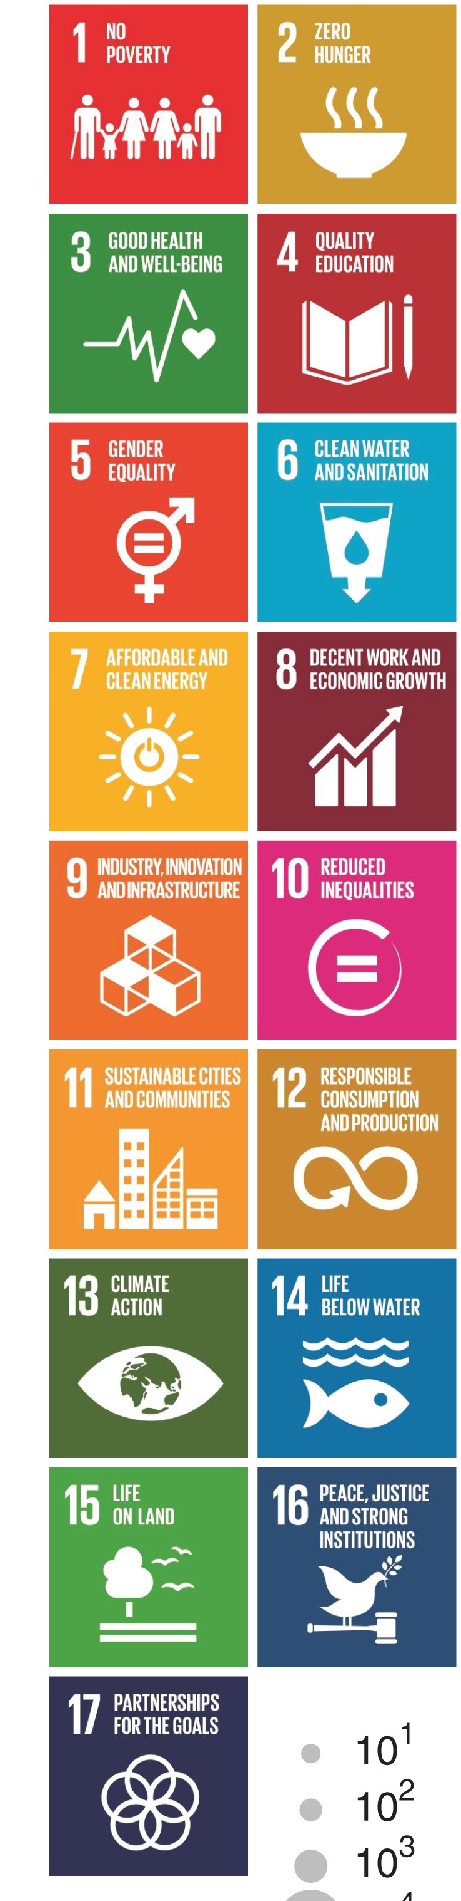
SDG interactions - empirical
Analysing correlation between official SDG indicators across more than 200 countries:
Overall positive correlation dominates, especially for SDG 1 (no poverty); SDG 12 (Responsible consumption and production) is most commonly associated with trade-offs with other SDGs
Pradhan et al. (2017)

Slide 17
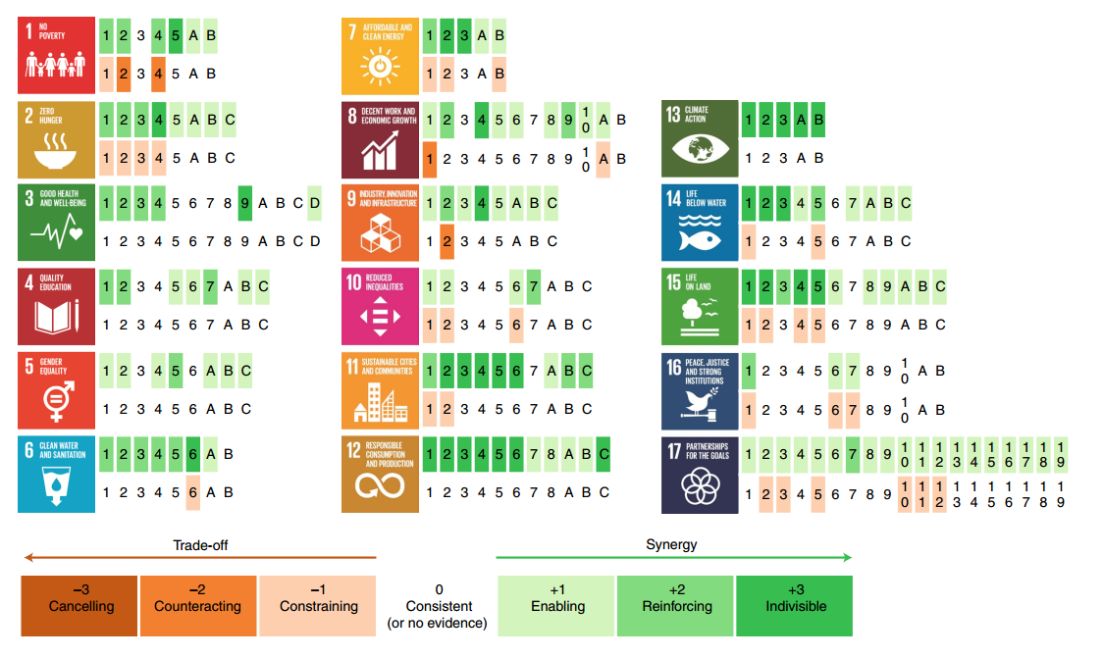
Climate action and SDGs are interconnected
Fuso Nerini et al. (2019)

Slide 18
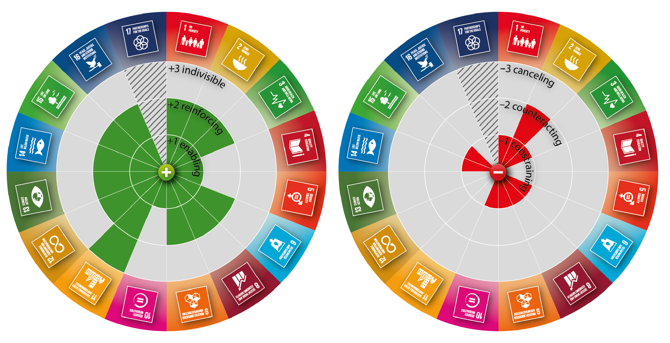
Energy and SDGs are interconnected
McCollum et al. (2018)

Slide 19
Integrated IAM – SDG research: Example Workflow
Five Integrated Assessment Models
Capacities and production
New Construction [MW/yr]
Electricity Production [kWh_{el}/yr]
Decomissions [MW/yr]
Impacts represented directly - Air pollution - Water use
- Fossil resources, CO2 storage
Prospective Life-Cycle Assessment (THEMIS)
Mid-point coefficients (technology-specific) per kWh_{el}, MW, e.g., - Toxicity - Land occupation
- Eutrophication
- Metal depletion - Ionizing radiation
Related midpoint impacts, including indirect effects due to embodied energy - Air pollution (PM, O3, TAC) - Water - Fossil depletion, CCS
MAgPIE bioenergy scenarios
Embodied energy coefficients
Joint assessment of midpoint and endpoint impacts (health, ecosystem damage, resource depletion)
Luderer et al. (2019)

Slide 20

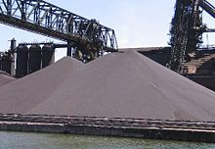
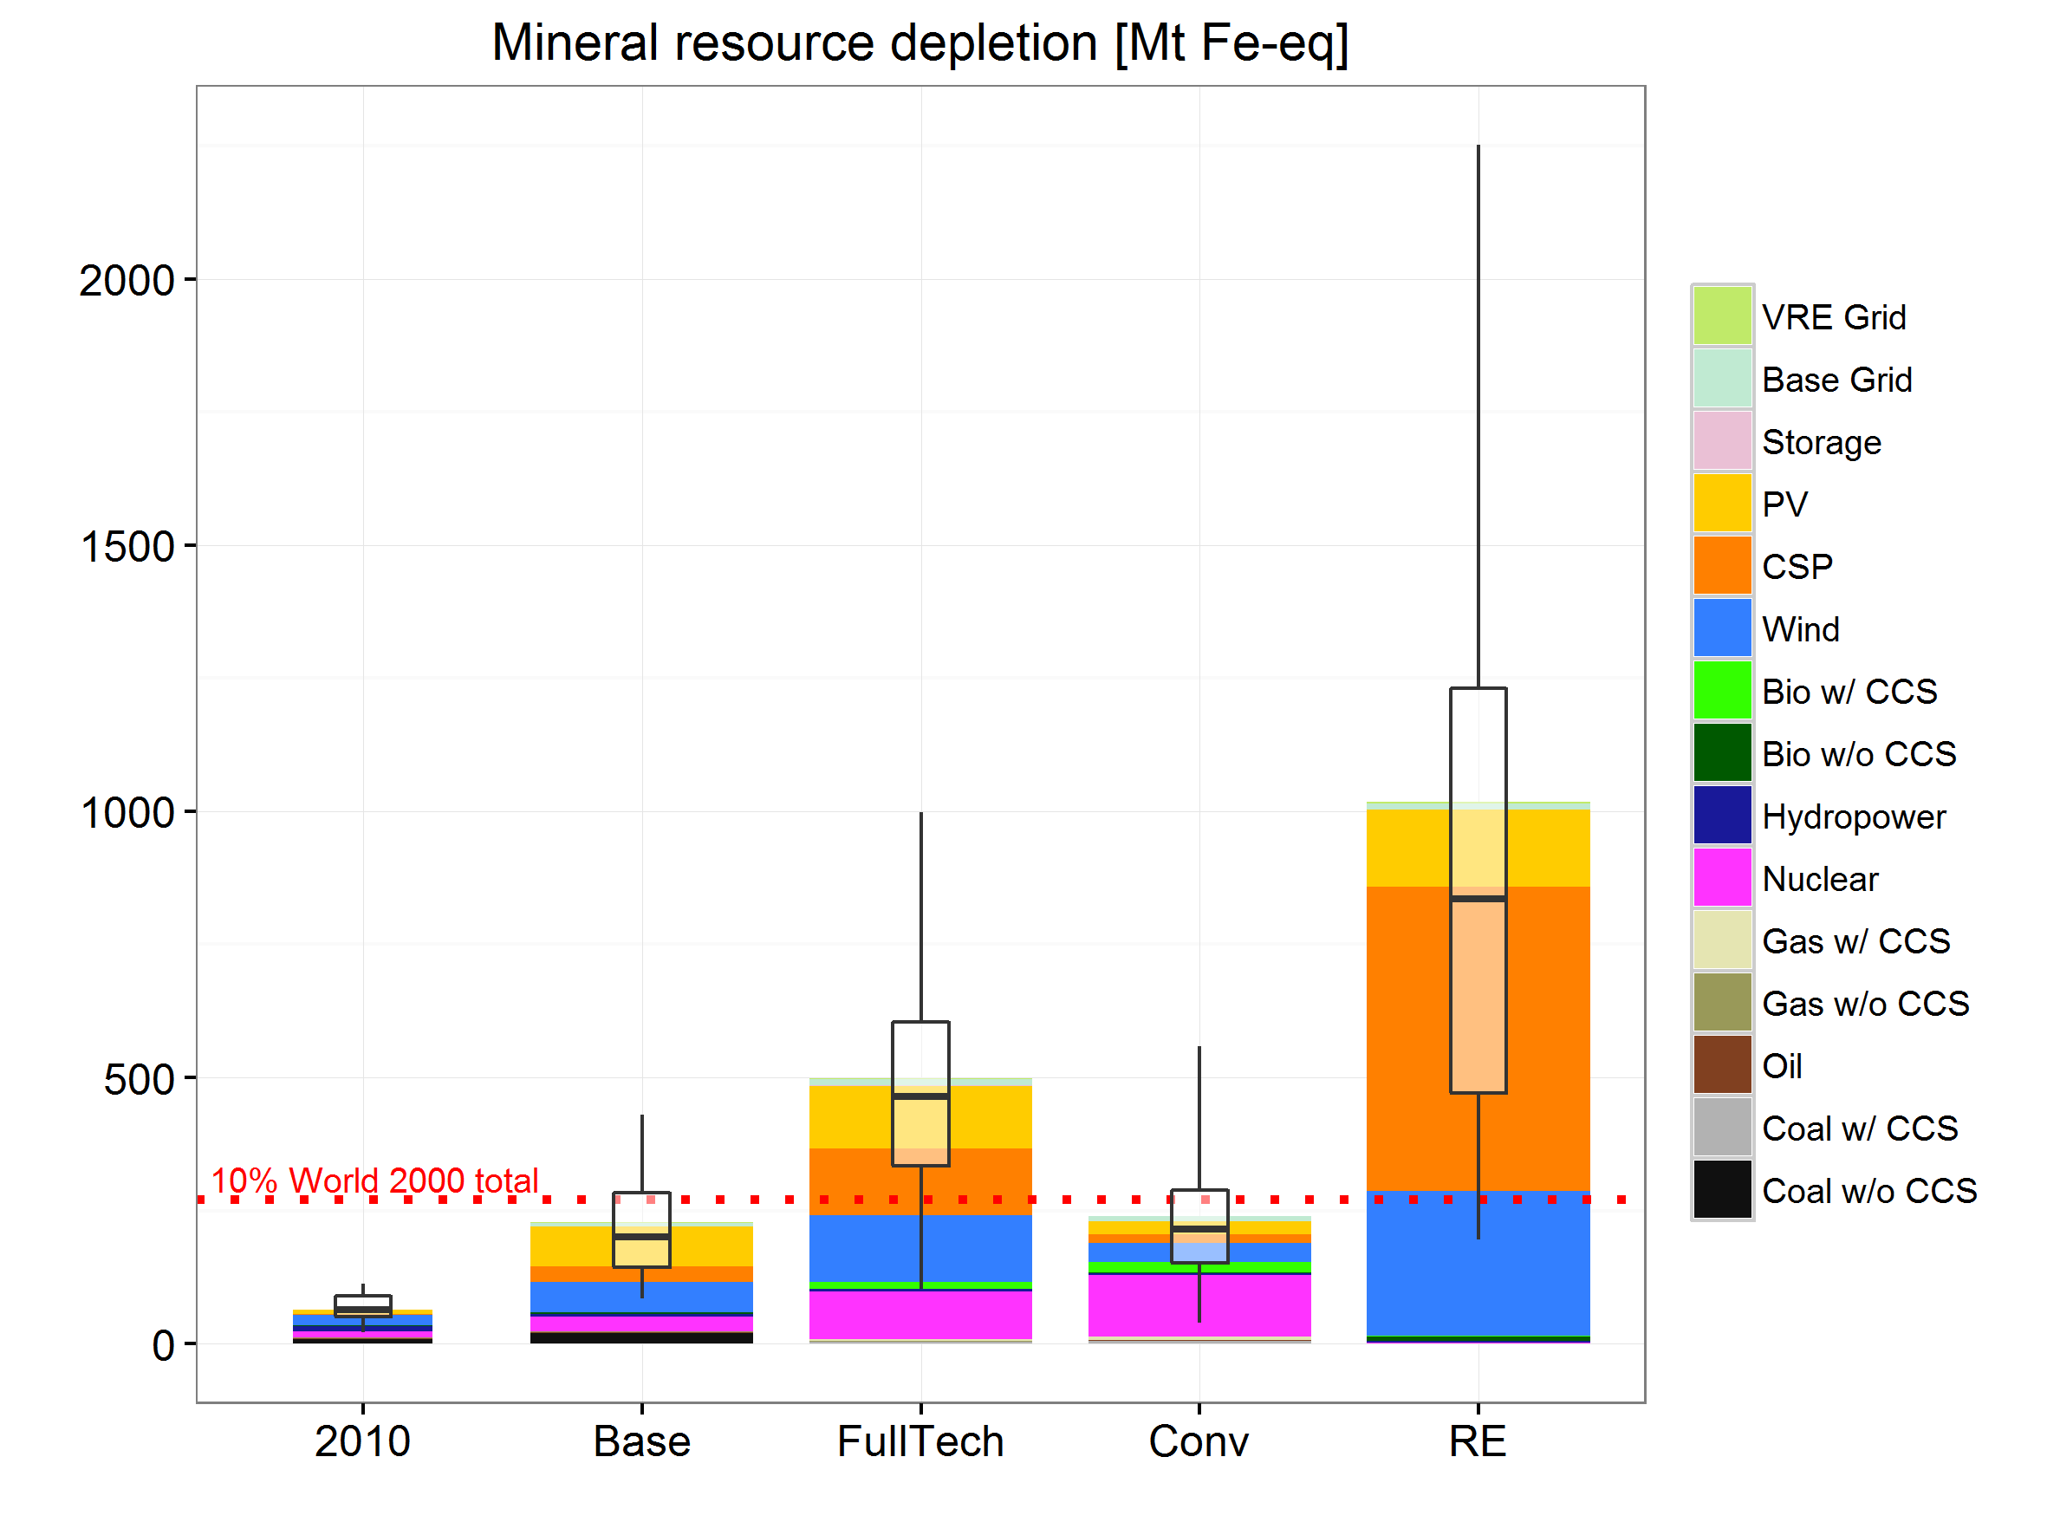
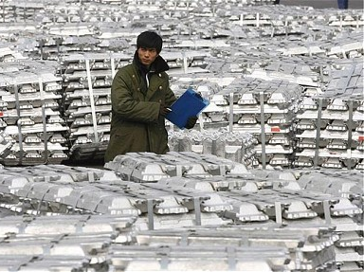
Mineral resource depletion
2050
Luderer et al. (2019)
Notes:
- Accounts for

Slide 21
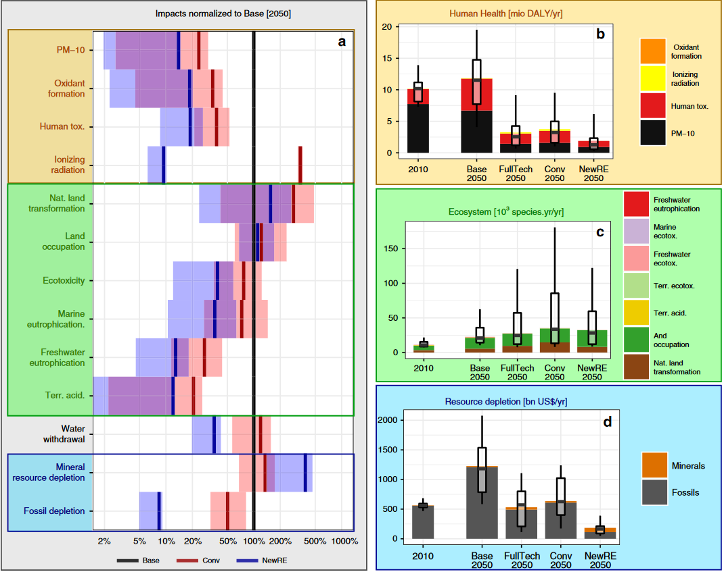
Adverse side effects
Co-benefits
Luderer et al. (2019)

Slide 22
Summary section 2.:
Empirical research shows strong synergies as well as some trade-offs across SDGs and targets
Various methodologies used lead to differences in results
IAM scenarios allow for scenario anlaysis of trade-offs
coupling to detailed models (like life-cycle assessment LCA tools) expands scope of covered aspects (and SDGs)
Renewable-focused mitigation strategies lower health and ecosystem impacts, as well as fossil resource depletion, but require larger mineral resource depletion

Slide 23
Policy options to maximize synergies and reduce trade-offs

Slide 24
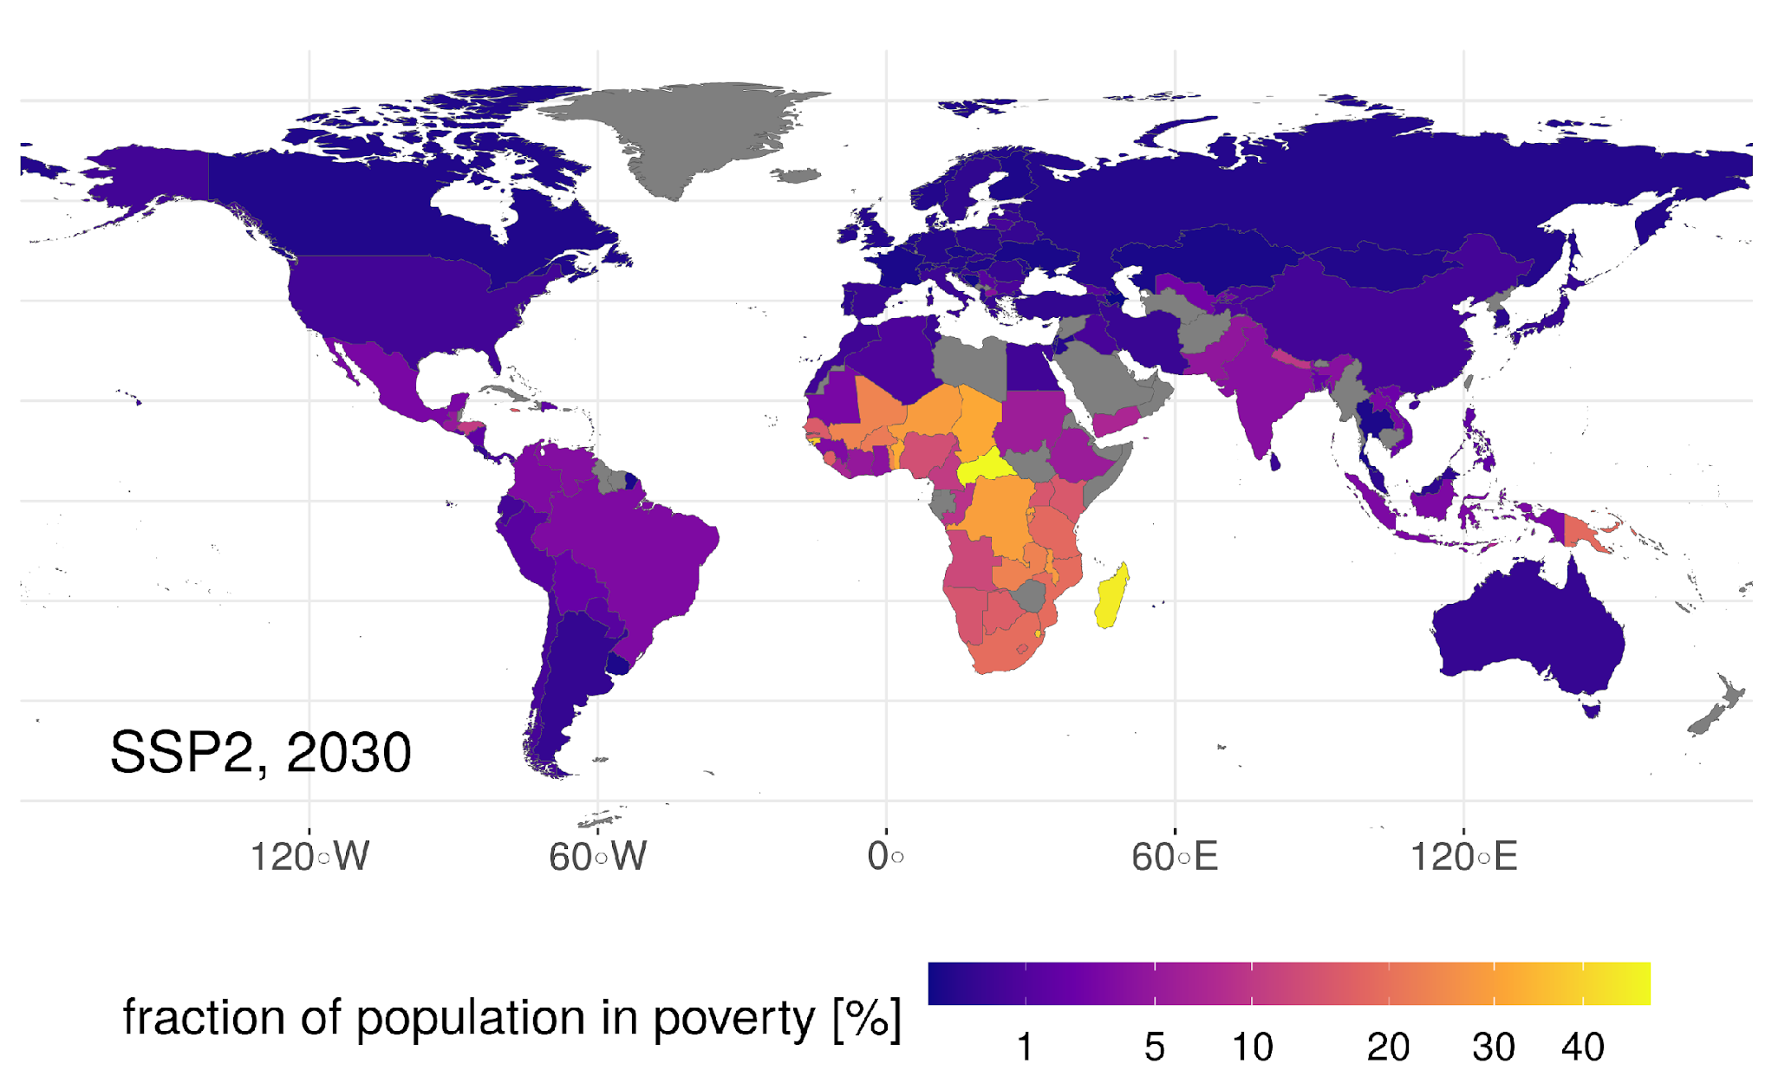
The world is not on track towards the targets
Projection for 2030 poverty rates (pre-COVID)
-> 350 million people left in extreme poverty by 2030
Soergel et al. (2021), Nature Communications

Slide 25
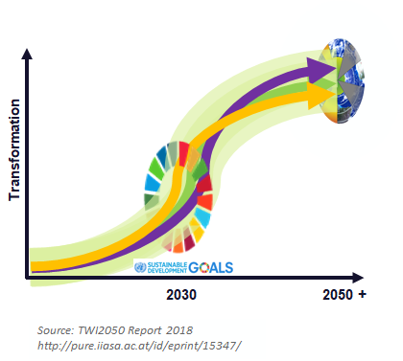
A sustainable development pathway (SDP)
SDP as “target-seeking” scenario:
as much progress towards SDGs as possible by 2030
continue sustainable development towards 2050 and beyond
meet climate targets of the Paris Agreement
respect Planetary Boundaries for other environmental indicators

Slide 26
A sustainable development pathway (SDP)
Current trends and policy actions extrapolated
(SSP2-NDC)
Soergel et al. (2021), Nature Climate Change

Slide 27




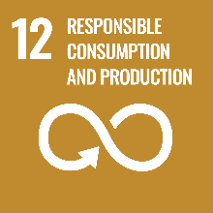
A sustainable development pathway (SDP)
Intervention A
(Development)
Current trends and policy actions extrapolated
(SSP2-NDC)
New trends towards sustainable development
(SSP1-NDC)
Intervention B
(Resource efficiency)
Soergel et al. (2021), Nature Climate Change

Slide 28
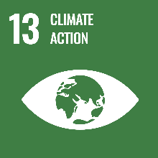
A sustainable development pathway (SDP)
Policies enacted to reach Paris climate goal
(SSP1-1.5C)
Intervention C
(Climate change mitigation)
Intervention A
(Development)
Current trends and policy actions extrapolated
(SSP2-NDC)
New trends towards sustainable development
(SSP1-NDC)
Intervention B
(Resource efficiency)
Soergel et al. (2021), Nature Climate Change

Slide 29
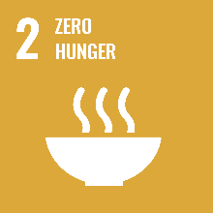

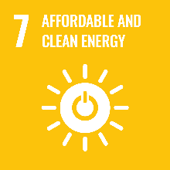

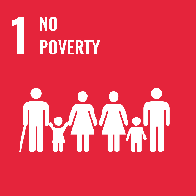

A sustainable development pathway (SDP)
Policies enacted to reach Paris climate goal
(SSP1-1.5C)
Holistic SD policy approach (SDP-1.5C)
Intervention D (Food & energy)
Intervention C
(Climate change mitigation)
Intervention A
(Development)
Current trends and policy actions extrapolated
(SSP2-NDC)
Intervention E (Global equity)
New trends towards sustainable development
(SSP1-NDC)
Intervention F (Equality & poverty alleviation)
Intervention B
(Resource efficiency)
Soergel et al. (2021), Nature Climate Change

Slide 30
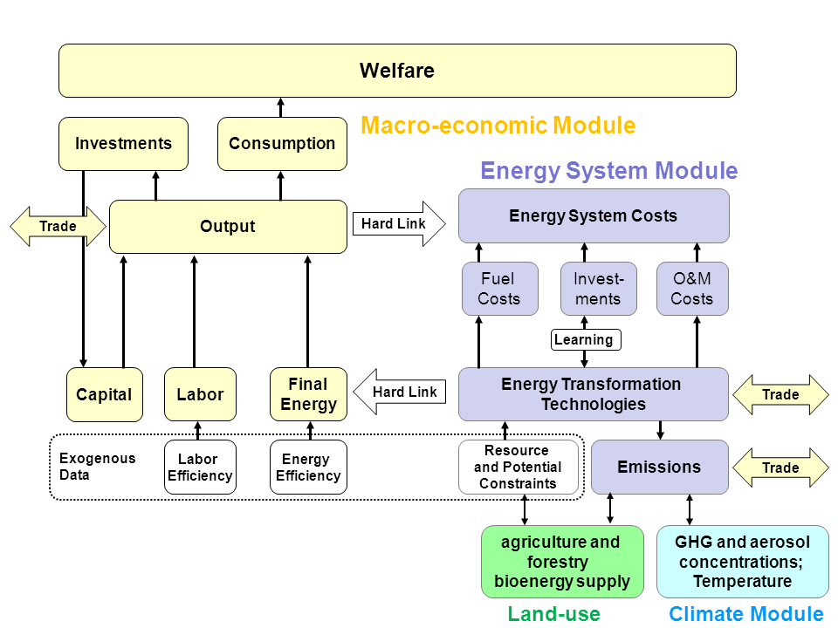
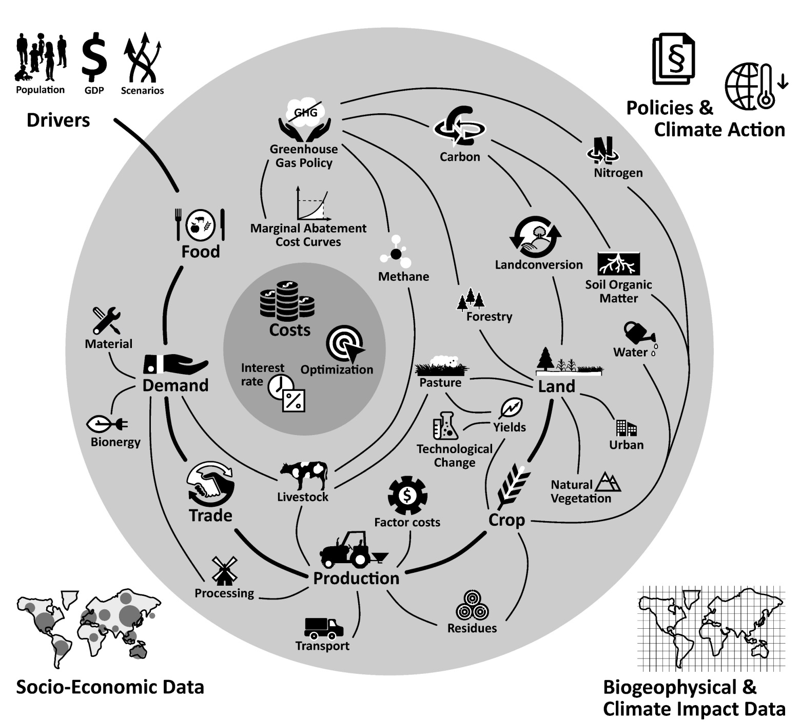
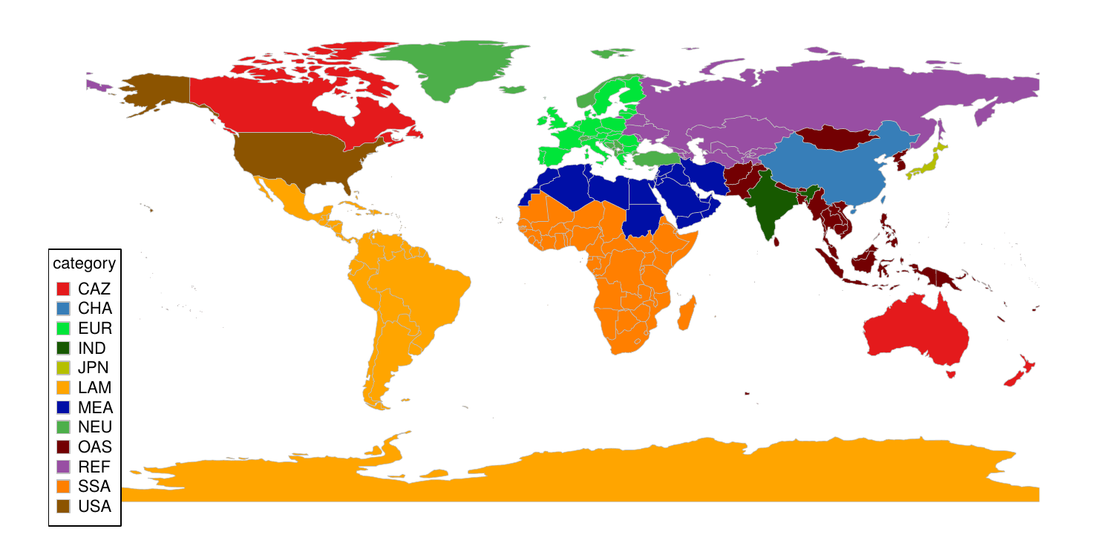
REMIND-MAgPIE framework
REMIND
MAgPIE
Resolution:
Flexible, default: 12 regions
Large countries as regions
Small countries grouped
(e.g. Luderer et al. 2015)
(Dietrich et al. 2018)
Land-use emi.,
Bioen. price
Carbon price,
Bioen. demand
Climate policy setting:
Policy starts after 2020
Staged accession: convergence to global carbon price in 2050
Energy and land-use system are interlinked.
29

Slide 31
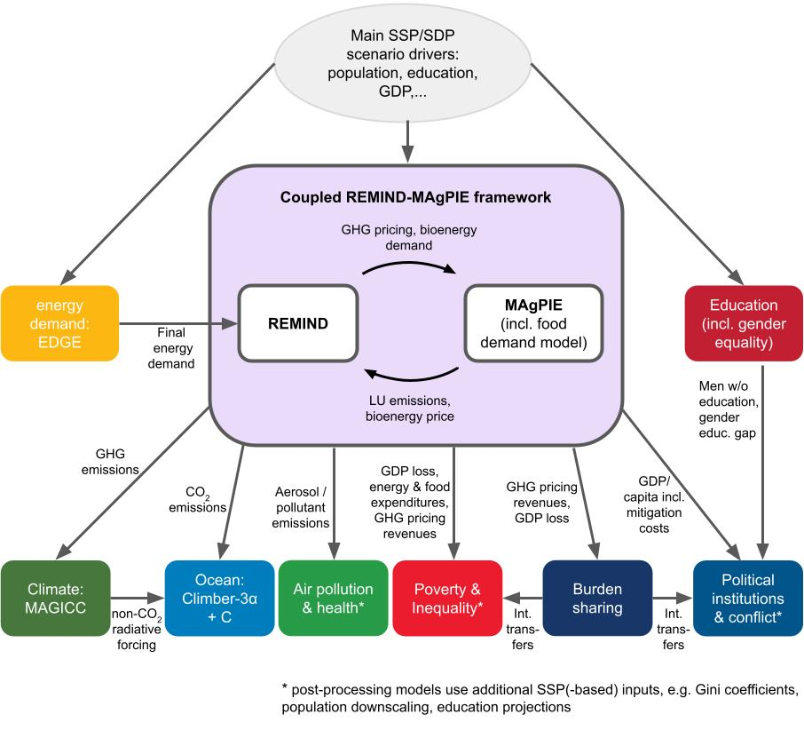
Modelling toolbox + indicators
SSP scenarios as basis
energy-economy-land-climate modelling framework REMIND-MAgPIE as workhorse
additional downstream models for SDG indicators
Ocean (SDG 14)
Air pollution & health (SDG 3,11)
Inequality & Poverty (SDG 1,10)
Political institutions & violent conflict (SDG 16)
Goal: quantify indicators or meaningful proxies for all 17 SDGs

Slide 32
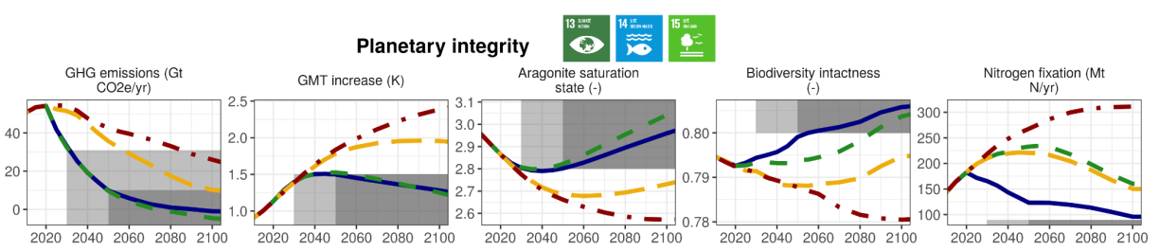
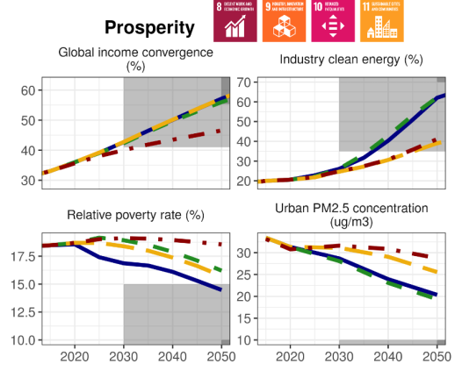
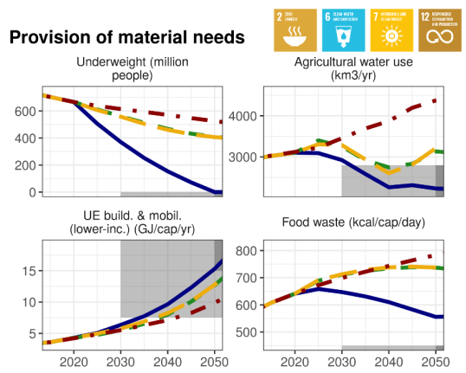
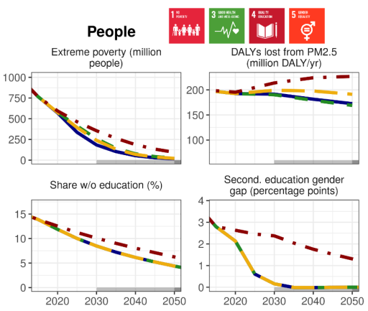
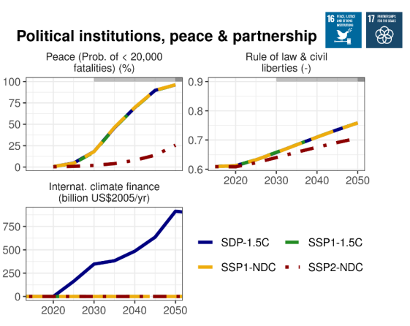
Comprehensive coverage of the SDG space
Soergel et al. (2021), Nature Climate Change

Slide 33
Comprehensive coverage of the SDG space
Soergel et al. (2021), Nature Climate Change

Slide 34
Interventions: Global equity & poverty alleviation
Intervention E (Global equity)
international redistribution of part of the carbon pricing revenues
-> ‘climate & development finance’
(ImPo: post-proc)
Intervention F (Equality & poverty alleviation)
national redistribution of carbon pricing revenues (+ int’l transfers) as equal-per-capita ‘climate dividend’
(ImPo: post-proc)
Legend*: Scenario Assumption; Implemented Policy; Model Dynamics

Slide 35
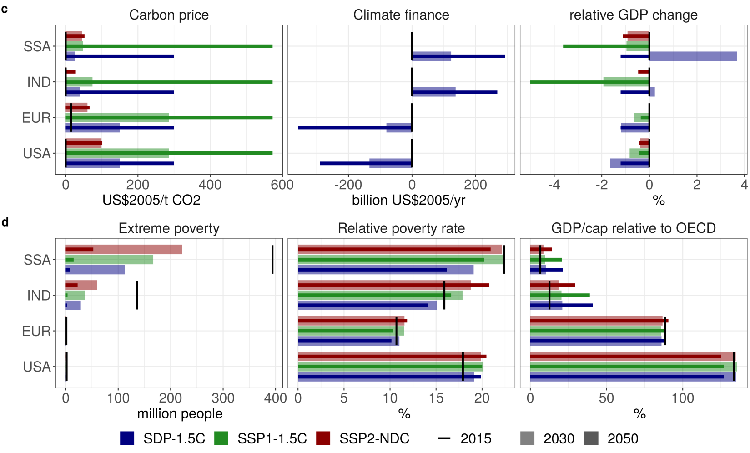
Burden sharing & climate & development finance
SDP: Carbon prices roughly halved compared to SSP1-1.5C
differentiated carbon prices & international climate finance: low policy costs for developing regions
redistribution of carbon pricing revenues reduces inequality and poverty
Soergel et al. (2021), Nature Climate Change

Slide 36
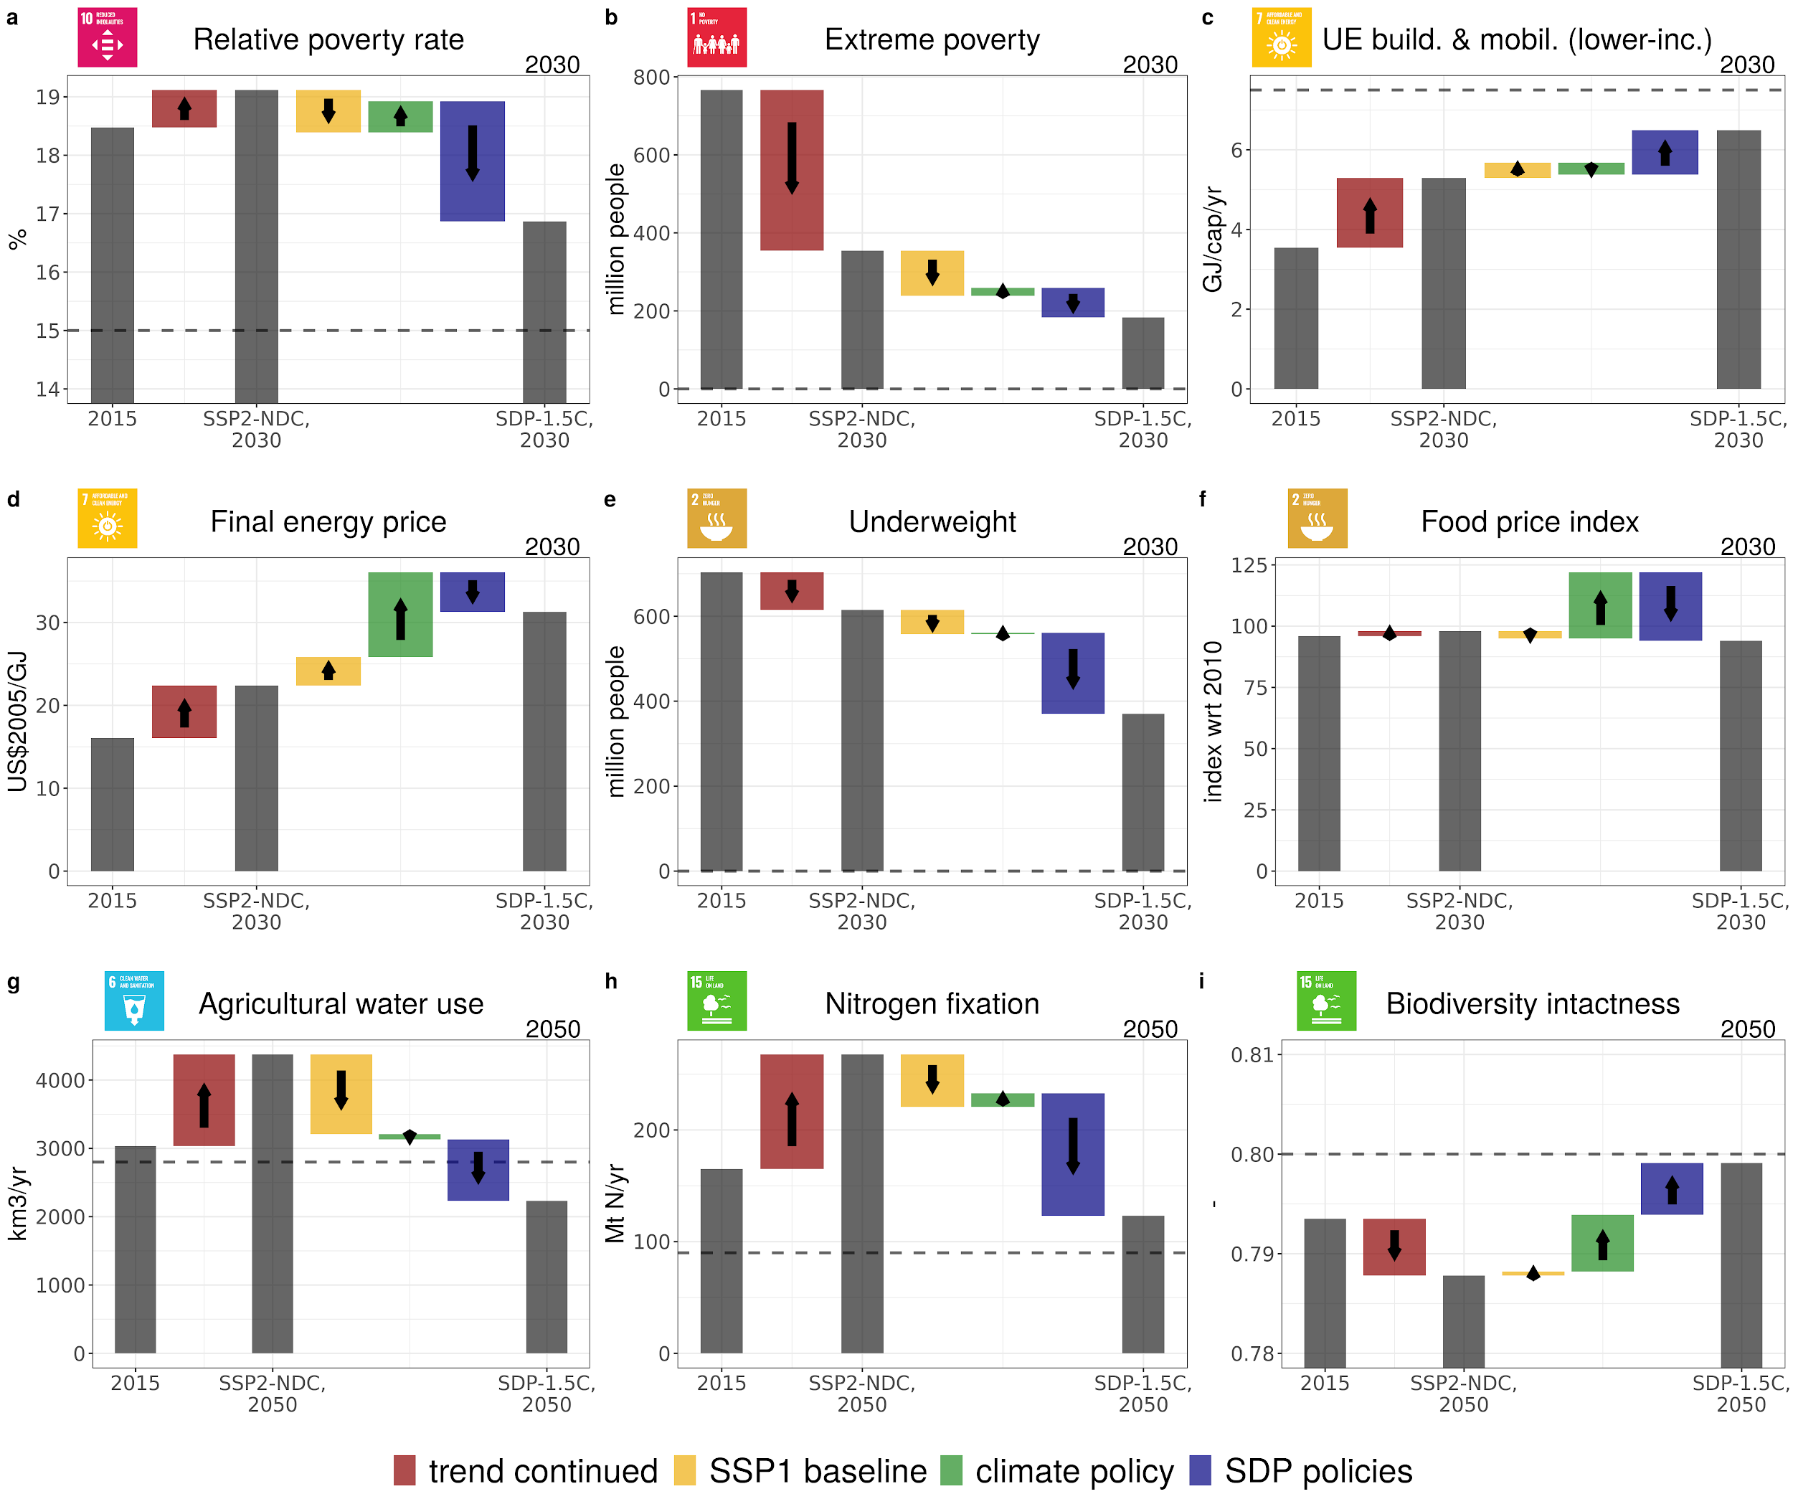




Effects of the interventions: inequality & poverty
Redistribution policies funded from carbon pricing revenues reduce inequality and poverty.
Climate policy trade-off is more than compensated.
Soergel et al. (2021), Nature Climate Change

Slide 37
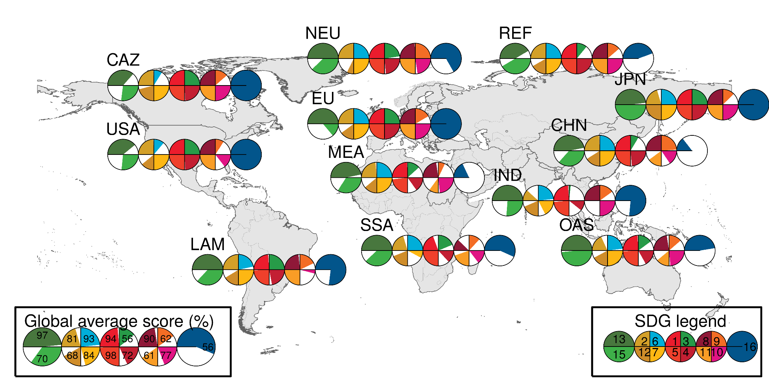
Regional SDG achievement and gaps (SDP 2030)
Planet
Provision
People
Prosperity
Political institutions...
Soergel et al., Nature Climate Change

Slide 38
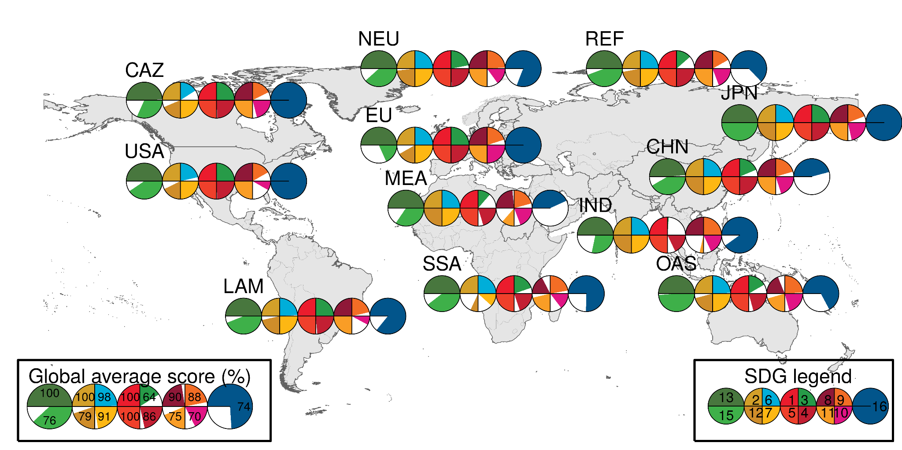
Regional SDG achievement and gaps (SDP 2050)
Planet
Provision
People
Prosperity
Political institutions...
Soergel et al., Nature Climate Change

Slide 39

Summary section 3.
development, resource efficiency and moderate lifestyle change + climate policies are insufficient to meet SDGs
additional SD interventions required:
global cooperation: “climate & development” scheme
national redistributive policies funded from carbon pricing revenues (“policy linking”)
food & energy -> co-benefits of healthy diets for climate, land, water, nitrogen cycle, biodiversity
=> Substantial improvements towards nearly all SDGs
comprehensive coverage of SDG space
SDG achievement gaps remain in 2030, but can largely be closed by 2050
Figure SPM.5e (IPCC 2022)

Slide 40
Future directions for IAM-related SDG research
More multi-dimensional, more granular analysis
More explicit representation of both end-point goals (aspects of well-being, like health, affluence, participation, safety and security), as well as preconditions (environmental integrity, resource availability)
Centrality of governance (which so far is blind spot of IAMs)
Endogeneity? (Moore et al. 2022)
Scenario approach with more detailed representation of political reality (IRA, EU Fit-for-55, behavioral changes, subnational scale…)

Slide 41
References
Bertram, Christoph, Gunnar Luderer, Alexander Popp, Jan Christoph Minx, William F. Lamb, Miodrag Stevanović, Florian Humpenöder, Anastasis Giannousakis, and Elmar Kriegler. 2018. ‘Targeted Policies Can Compensate Most of the Increased Sustainability Risks in 1.5 °C Mitigation Scenarios’. Environmental Research Letters 13 (6): 064038. https://doi.org/10.1088/1748-9326/aac3ec.
Calvin, Katherine, Marshall Wise, Page Kyle, Pralit Patel, Leon Clarke, and Jae Edmonds. 2014. ‘Trade-Offs of Different Land and Bioenergy Policies on the Path to Achieving Climate Targets’. Climatic Change 123 (3–4): 691–704. https://doi.org/10.1007/s10584-013-0897-y.
Fuso Nerini, Francesco, Benjamin Sovacool, Nick Hughes, Laura Cozzi, Ellie Cosgrave, Mark Howells, Massimo Tavoni, Julia Tomei, Hisham Zerriffi, and Ben Milligan. 2019. ‘Connecting Climate Action with Other Sustainable Development Goals’. Nature Sustainability 2 (8): 674–80. https://doi.org/10.1038/s41893-019-0334-y.
Iyer, Gokul, Katherine Calvin, Leon Clarke, James Edmonds, Nathan Hultman, Corinne Hartin, Haewon McJeon, Joseph Aldy, and William Pizer. 2018. ‘Implications of Sustainable Development Considerations for Comparability across Nationally Determined Contributions’. Nature Climate Change 8 (2): 124–29. https://doi.org/10.1038/s41558-017-0039-z.
Luderer, Gunnar, Michaja Pehl, Anders Arvesen, Thomas Gibon, Benjamin L. Bodirsky, Harmen Sytze de Boer, Oliver Fricko, et al. 2019. ‘Environmental Co-Benefits and Adverse Side-Effects of Alternative Power Sector Decarbonization Strategies’. Nature Communications 10 (1): 5229. https://doi.org/10.1038/s41467-019-13067-8.
McCollum, David L., Luis Gomez Echeverri, Sebastian Busch, Shonali Pachauri, Simon Parkinson, Joeri Rogelj, Volker Krey, et al. 2018. ‘Connecting the Sustainable Development Goals by Their Energy Inter-Linkages’. Environmental Research Letters 13 (3): 033006. https://doi.org/10.1088/1748-9326/aaafe3.
Pradhan, Prajal, Luís Costa, Diego Rybski, Wolfgang Lucht, and Jürgen P. Kropp. 2017. ‘A Systematic Study of Sustainable Development Goal (SDG) Interactions’. Earth’s Future 5 (11): 1169–79. https://doi.org/10.1002/2017EF000632.
Soergel, Bjoern, Elmar Kriegler, Benjamin Leon Bodirsky, Nico Bauer, Marian Leimbach, and Alexander Popp. 2021. ‘Combining Ambitious Climate Policies with Efforts to Eradicate Poverty’. Nature Communications 12 (1): 2342. https://doi.org/10.1038/s41467-021-22315-9.
Soergel, Bjoern, Elmar Kriegler, Isabelle Weindl, Sebastian Rauner, Alois Dirnaichner, Constantin Ruhe, Matthias Hofmann, et al. 2021. ‘A Sustainable Development Pathway for Climate Action within the UN 2030 Agenda’. Nature Climate Change 11 (8): 656–64. https://doi.org/10.1038/s41558-021-01098-3.
Soest, Heleen L. van, Detlef P. van Vuuren, Jérôme Hilaire, Jan C. Minx, Mathijs J. H. M. Harmsen, Volker Krey, Alexander Popp, Keywan Riahi, and Gunnar Luderer. 2019. ‘Analysing Interactions among Sustainable Development Goals with Integrated Assessment Models’. Global Transitions 1 (January): 210–25. https://doi.org/10.1016/j.glt.2019.10.004.
Stechow, Christoph von, Jan C. Minx, Keywan Riahi, Jessica Jewell, David L. McCollum, Max W. Callaghan, Christoph Bertram, Gunnar Luderer, and Giovanni Baiocchi. 2016. ‘2 °C and SDGs: United They Stand, Divided They Fall?’ Environmental Research Letters 11 (3): 034022. https://doi.org/10.1088/1748-9326/11/3/034022.

Slide 42
Discussion

Slide 43
Back-up

Slide 44
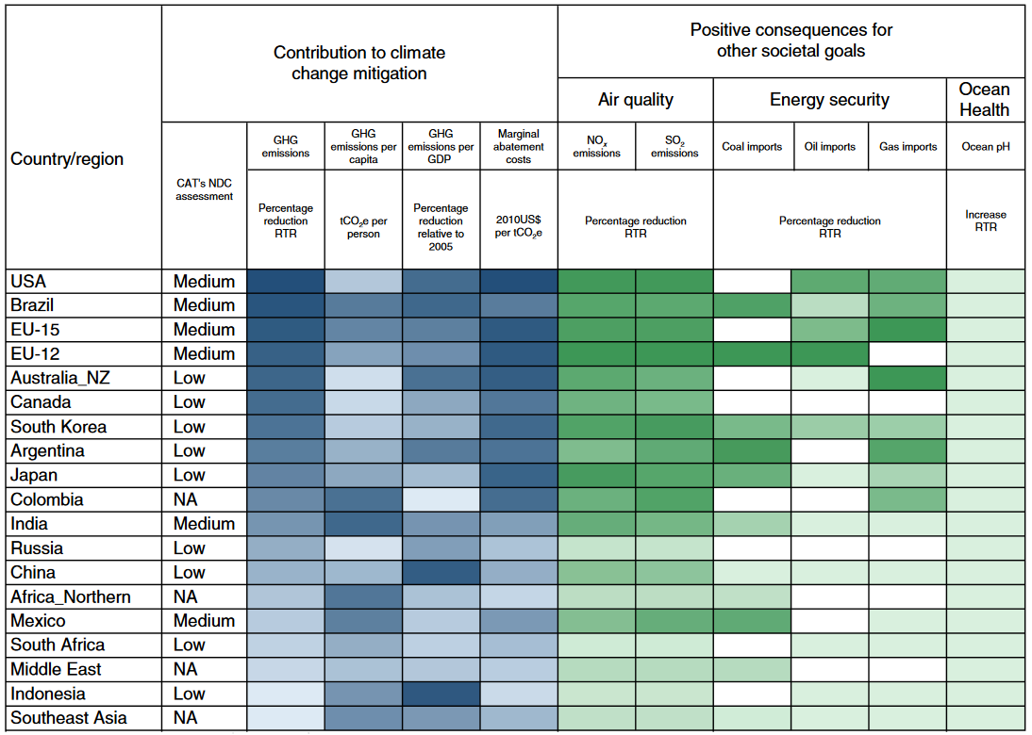
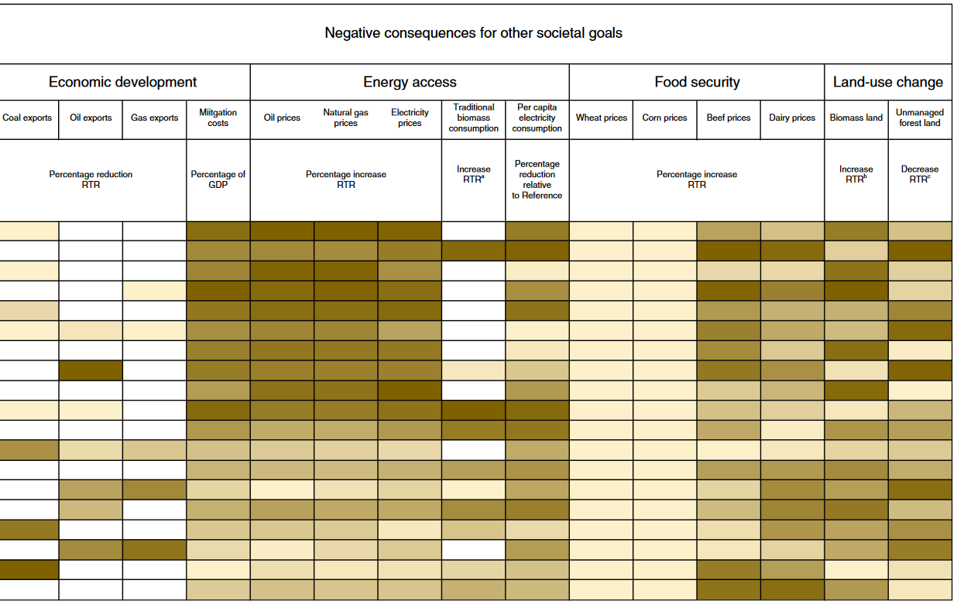
Implications of SDG considerations for comparability across NDCs
Iyer et al. (2018)
Notes:
Food security
Land-Use change

Slide 45
Interventions: Food and energy
Intervention D (Food & energy)
transition to zero hunger and healthy and sustainable diets (EAT-Lancet) by 2050
(ScAs)
meet energy demand for decent living standards in developing regions
(ScAs / MoDy)
reduce energy consumption in high-income regions
(ScAs / MoDy)
additional energy and land system sustainability policies, e.g. coal phase out, BECCS limit, biodiversity hotspot protection
(ImPo: constraint)
Legend*: Scenario Assumption; Implemented Policy; Model Dynamics
* see Supplementary Tables of paper for detailed description

Slide 46
Effects of the interventions: food
Transition to healthy and sustainable nutrition (EAT-Lancet)
Prevalence of underweight is substantially reduced (zero by 2050)
Effect of climate policy on food prices is fully compensated.
Soergel et al. (2021), Nature Climate Change

Slide 47
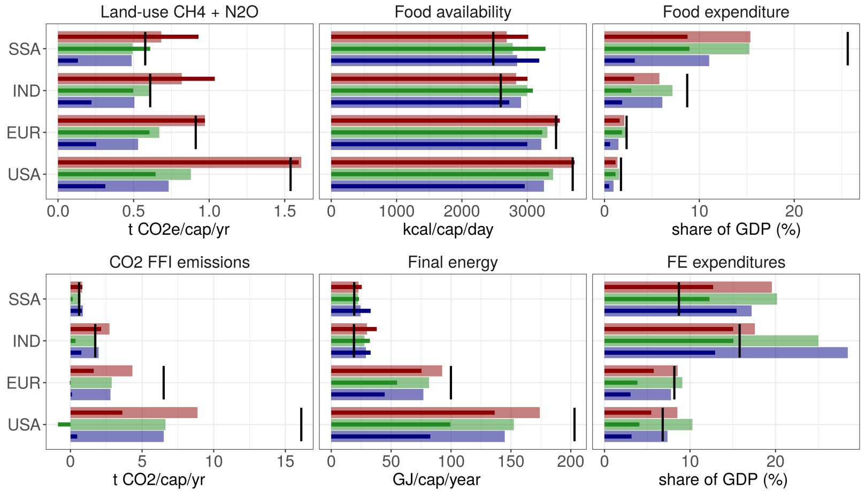
Food and land-use system
SDP: Transition to sustainable diets:
rapid reduction of agricultural emissions
slightly (100 Gt) higher 1.5°C-compatible CO₂ budget
Soergel et al. (2021), Nature Climate Change

Slide 48
Effects of the interventions: land & water
Planetary boundaries in 2050
Large co-benefits of healthy and sustainable nutrition for multiple planetary boundaries.
Soergel et al. (2021), Nature Climate Change

Slide 49
Effects of the interventions: energy
improved availability of modern energy services in lower-income regions
ambitious shift to sustainable lifestyles in high-income regions
price increase caused by climate policy is dampened
Soergel et al. (2021), Nature Climate Change

Slide 50
Energy system
SDP energy demands:
ambitious reductions in high-income regions
higher, SDG-compatible energy demands in low-income regions
Trade-off: higher energy expenditures in near term (compensated, see below)
Soergel et al. (2021), Nature Climate Change

Slide 51
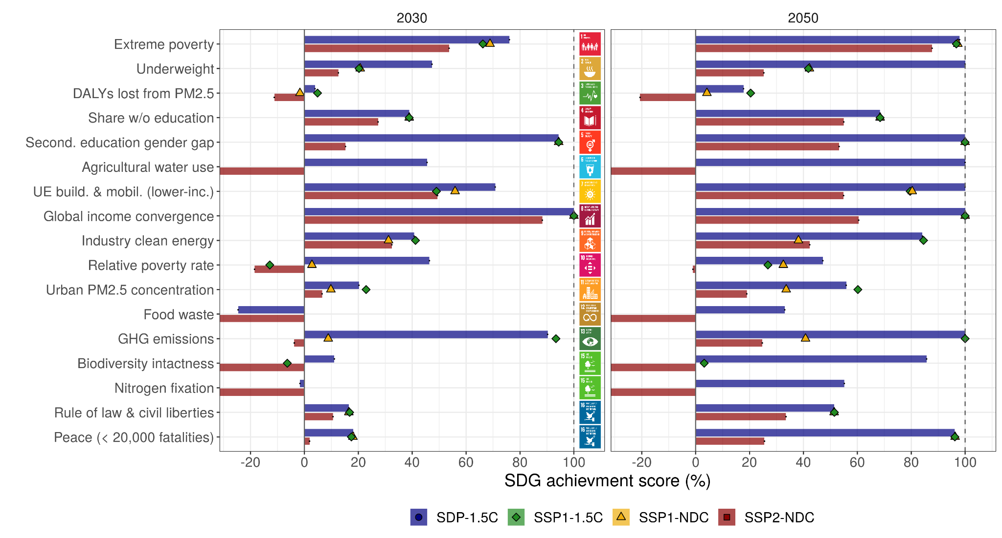
Global SDG achievement and gaps
SDP scenario improves substantially over reference scenario across nearly all SDGs.
Nonetheless: many targets are difficult to meet by 2030.
Further progress until 2050 can close most of the gaps.
SD scenario
trends continued
Soergel et al. (2021), Nature Climate Change

Slide 52
Sustainability benefits and sustainability risks of deep decarbonization: do policy assumptions matter?
 |  | Policy paradigm
 |  | Default | Regulation | Early action | Lifestyle | Sustainable
 |  | Carbon price increasing at 5% p.a. “cost-effective” | Water and forest protection; Nuclear phase-out; CCS constraint | Higher initial carbon price increase at 3% p.a., lower land-use carbon price | Healthier diets; Lower energy use | Regulation, early action, lifestyle policy approaches combined
Stabilization target (CO₂ budgets 2011-2100 in Gt) | Reference (no mitigation) | REF_Def |  |  |  | REF_Sust
 | Well below 2ºC limit (1000) | 2°C_Def | 2°C_regul | 2°C_early | 2°C_lifesty | 2°C_Sust
 | 1.5ºC limit (400) | 1.5°C_Def | 1.5°C_regul | 1.5°C_early | 1.5°C_lifesty | 1.5°C_Sust
11

Slide 53
Different CO₂ emission profiles
Total CO₂
REF_Def (No-policy baseline)
2ºC_Def (2ºC w. c-price only) 2ºC_Sust (2ºC w. sustain. policies)
1.5ºC_Def (1.5ºC w. c-price only)
1.5ºC_Sust (1.5ºC w. sustain. policies)
50
Gt CO₂ /yr
25
2ºC scenarios from Rogelj et al 2015
1.5ºC scenarios from Rogelj et al 2015
0
EDGAR
2000 2020 2040 2060 2080 2100
12

Slide 54

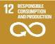




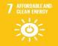
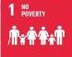
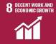
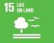
Different profiles in sustainability indicators
←Mitigation benefits
SO₂ from En. Supply
2030 (Mt SO₂/yr)
Fossil ressource extr.
2050 (EJ/yr)
Air pollution
30
20
10
0
800
400
Extraction
Temp. rel. to 2015
2050 (K)
0
Water withdrawal
2030 (1000 km³/yr)
Termperature
1.0
3
2
1
0
0.5
Water
0
Cumulated Uranium
2015-2050 (Mt U)
Fertilizer use
2030 (Mt N2/yr)
Uranium
12
9
6
3
0
100
50
0
Fertilizer
Food Price
Food Price Increase
2030 (% of 2015)
Energy Price Inc.
2030 (% of 2015)
50
40
20
0
Energy Price
30
Mitigation risks →
10
−10
Short Term Cost
2015−2050 (%)
LongTerm Cost
2050−2100 (%)
Short Term Cost
Long Term Cost
1.5
1.0
0.5
0.0
4
2
0
Energy cropland
Av. energy cropland
2050−2100 (mio. ha)
Cum. carbon stored
2015−2100 (Gt CO2)
CCS
300
200
100
0
800
400
0
REF_Def
2ºC_Def
12.5% 25% 50% 100% 200% 400%
rel. to 2ºC_Def value
REF_Def
2ºC_Def
REF_Def
2ºC_Def
13

Slide 55
Different profiles in sustainability indicators
←Mitigation benefits
SO₂ from En. Supply
2030 (Mt SO₂/yr)
Fossil ressource extr.
2050 (EJ/yr)
Air pollution
30
20
10
0
800
400
Extraction
Temp. rel. to 2015
2050 (K)
0
Water withdrawal
2030 (1000 km³/yr)
Termperature
1.0
3
2
1
0
0.5
Water
0
Cumulated Uranium
2015-2050 (Mt U)
Fertilizer use
2030 (Mt N2/yr)
Uranium
12
9
6
3
0
100
50
0
Fertilizer
Food Price
Food Price Increase
2030 (% of 2015)
Energy Price Inc.
2030 (% of 2015)
50
40
20
0
Energy Price
30
Mitigation risks →
10
−10
Short Term Cost
2015−2050 (%)
LongTerm Cost
2050−2100 (%)
Short Term Cost
Long Term Cost
1.5
1.0
0.5
0.0
4
2
0
Energy cropland
Av. energy cropland
2050−2100 (mio. ha)
Cum. carbon stored
2015−2100 (Gt CO2)
CCS
300
200
100
0
800
400
0
REF_Def
2ºC_Def
2ºC_Sust
1.5ºC_Def
1.5ºC_Sust
12.5% 25% 50% 100% 200% 400%
rel. to 2ºC_Def value
REF_Def
2ºC_Def
2ºC_Sust
1.5ºC_Def
1.5ºC_Sust
REF_Def
2ºC_Def
1.5ºC_Sust
1.5ºC_Def
14

